Slide 1

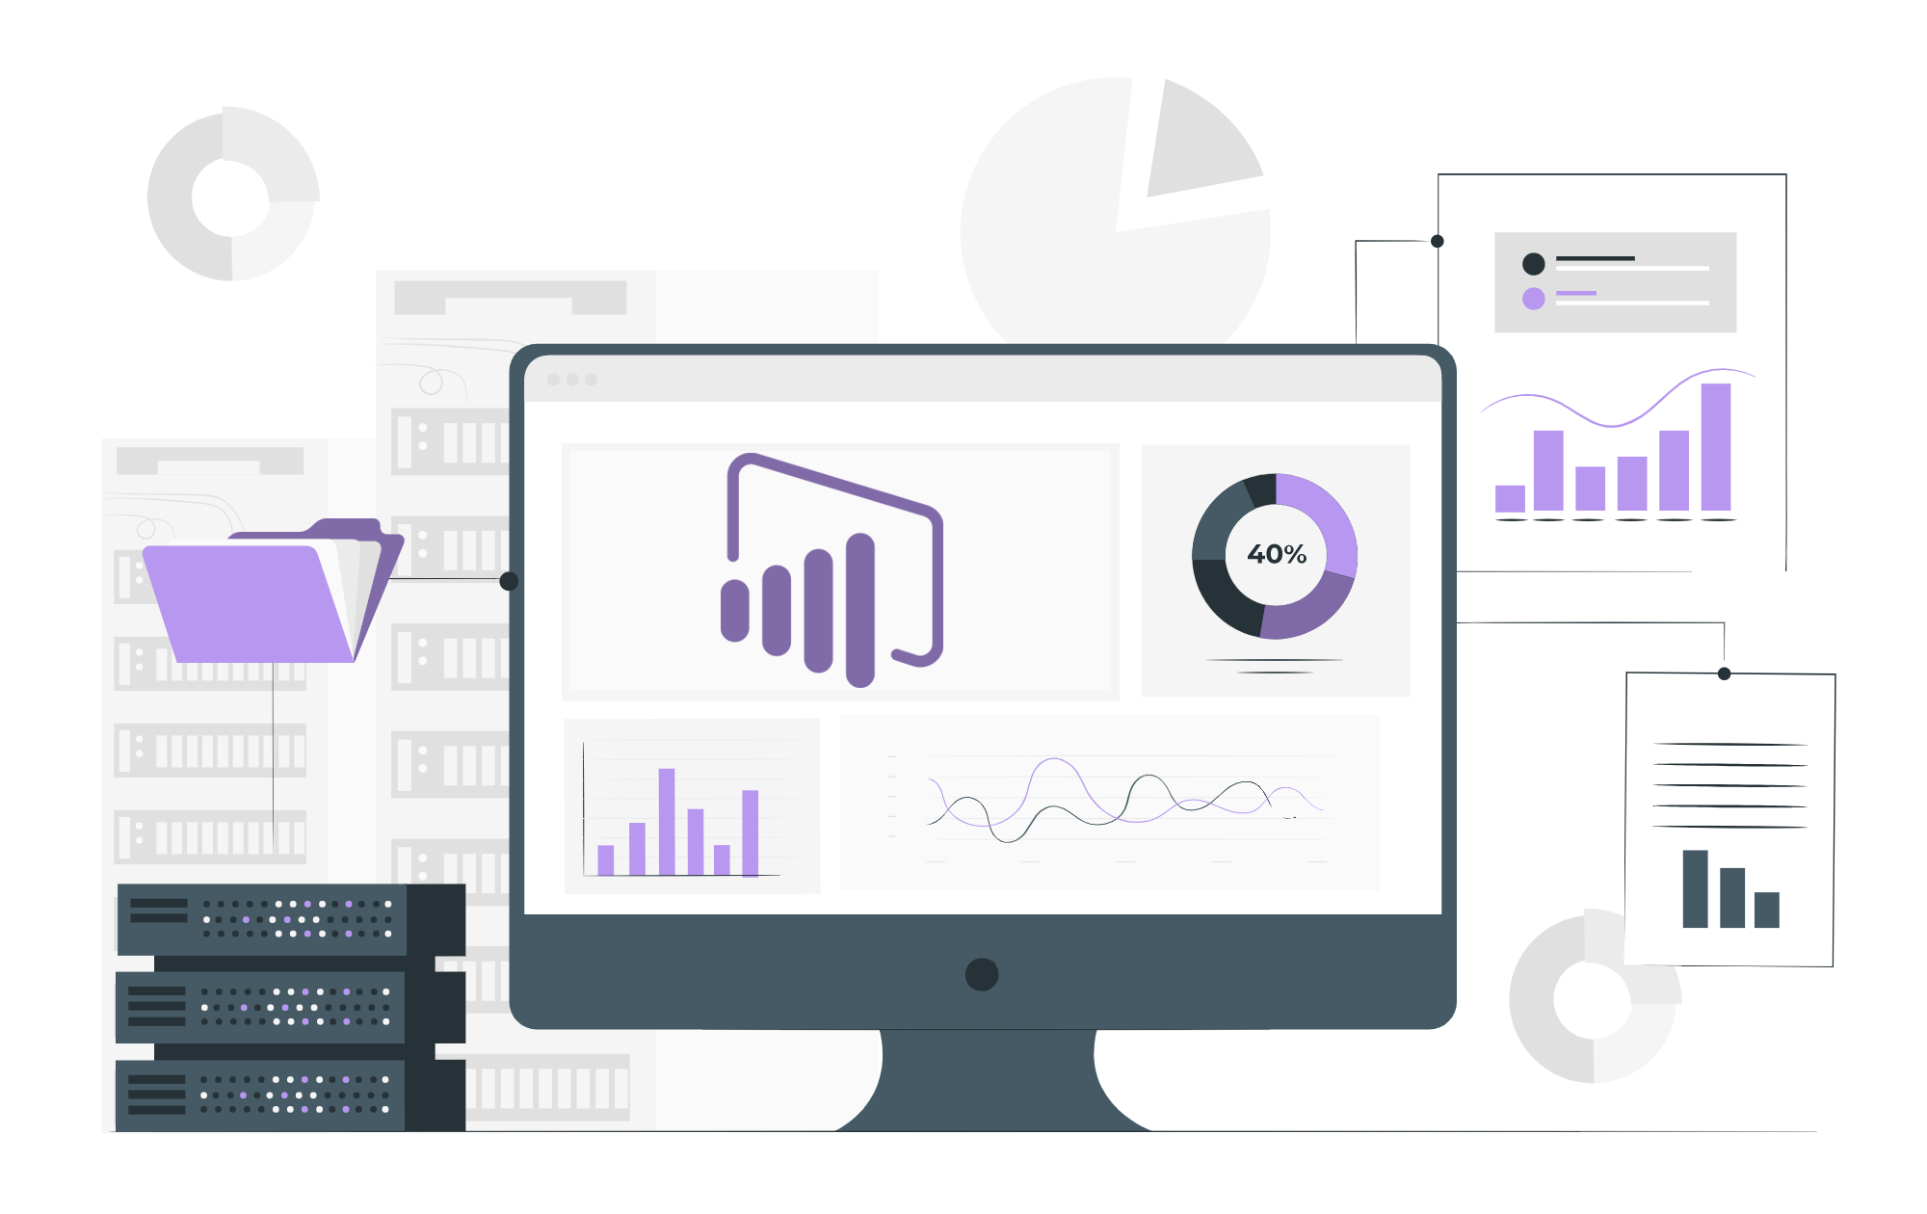
Solving Puzzles and Guesstimates

Slide 2
Agenda
Puzzles
Guesstimates

Slide 3
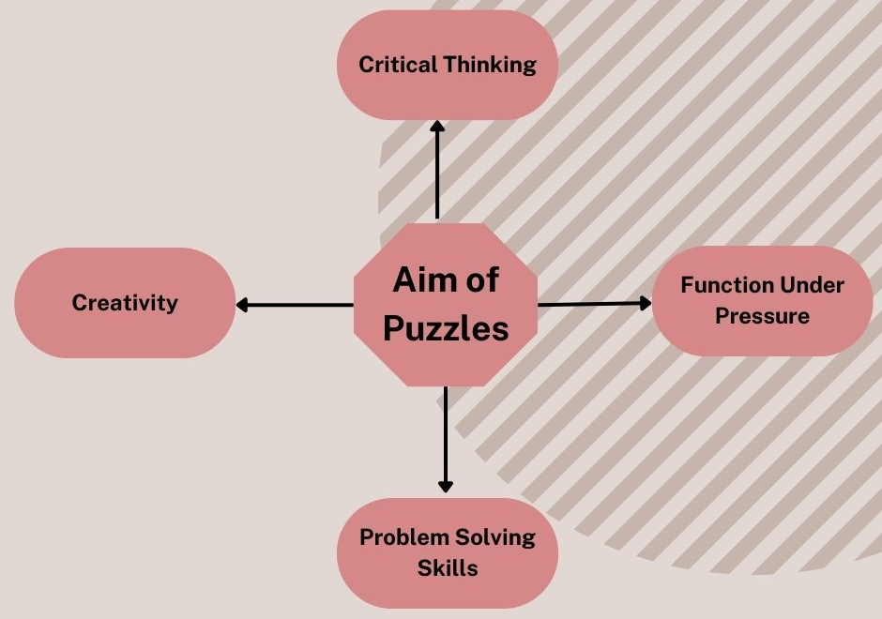
What is Puzzles?
Puzzles are problems or challenges that require thought, ingenuity, and often patience to solve.

Slide 4
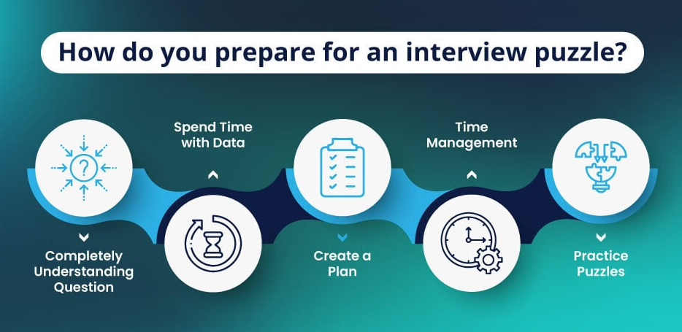

Slide 5


Slide 6

Rolling the bullet
Two bullets are loaded into a gun's round barrel consecutively. The barrel has a capacity of 6. The gun is fired once, but no bullet is shot. Does rolling the barrel (shuffling) before next shot increase the probability of firing a bullet?
Hint:
Since the bullets are loaded consecutively,
the next shot is also constrained.

Slide 7

The Returning Explorer
An explorer walks:
1 mile South
1 mile East
1 mile North.
And finds themselves back at the starting point. The explorer spots a bear, what is the color of the bear?

Slide 8

Lucky Candy
How do you place 50 good candies and 50 rotten candies in two boxes such that if you choose a box at random and take out a candy at random, it better be good!
We need to maximize the probability of getting a good candy when selecting a random box and a random candy from it.
Hint:
Placing all bad in 1 box and all good in another
will give the probability of 0.5, which is not the maximum.

Slide 9
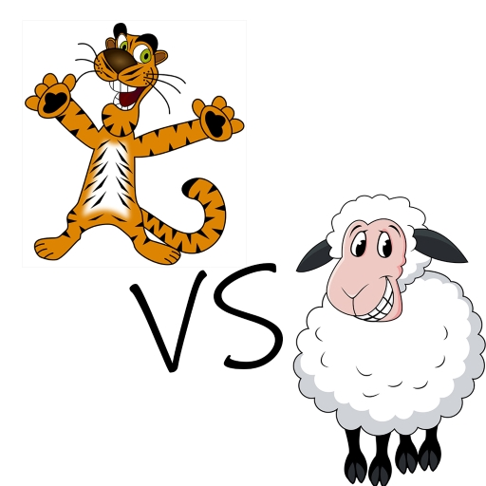
Tigers & The Sheep
Hundred tigers and one sheep are put on a magic island that only has grass. Tigers can live on grass, but they want to eat sheep. If a Tiger bites the Sheep then it will become a sheep itself. If 2 tigers attack a sheep, only the first tiger to bite converts into a sheep. Tigers don’t mind being a sheep, but they have a risk of getting eaten by another tiger. All tigers are intelligent and want to survive. Will the sheep survive?

Slide 10
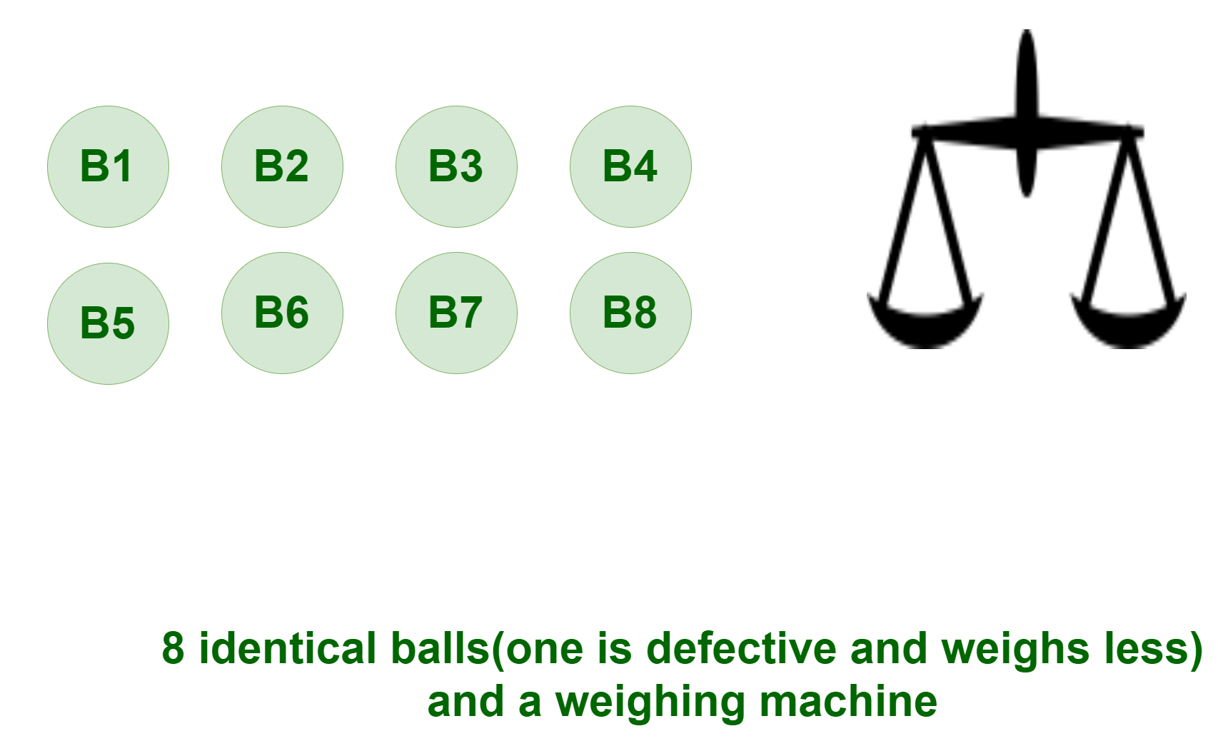
8 Balls Problem
You are provided with 8 identical balls and a measuring instrument. 7 of the eight balls are equal in weight and one of the eight given balls is defective and weighs less. The task is to find the defective ball in exactly two measurements.

Slide 11
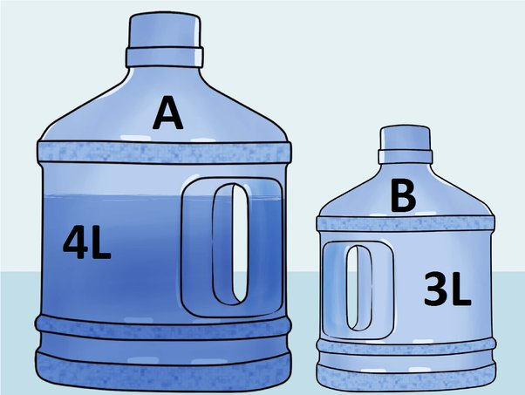
Fill the Jug
There are two jugs each of 4 and 3 liters respectively , without any measuring marks. how many minimum steps are required to have 2 liters of water into the 4 litre jug (the jugs can be filled any number of times with water, and they can be emptied any number of times).

Slide 12

Measuring without Measurements
With the help of two buckets and a water tap, a specific amount of water must be measured. One bucket holds 5 liters and the other bucket holds 3 liters. Both containers are lacking measurement indicators.
How can you measure a liquid amount of 4 liters using only these two buckets?

Slide 13
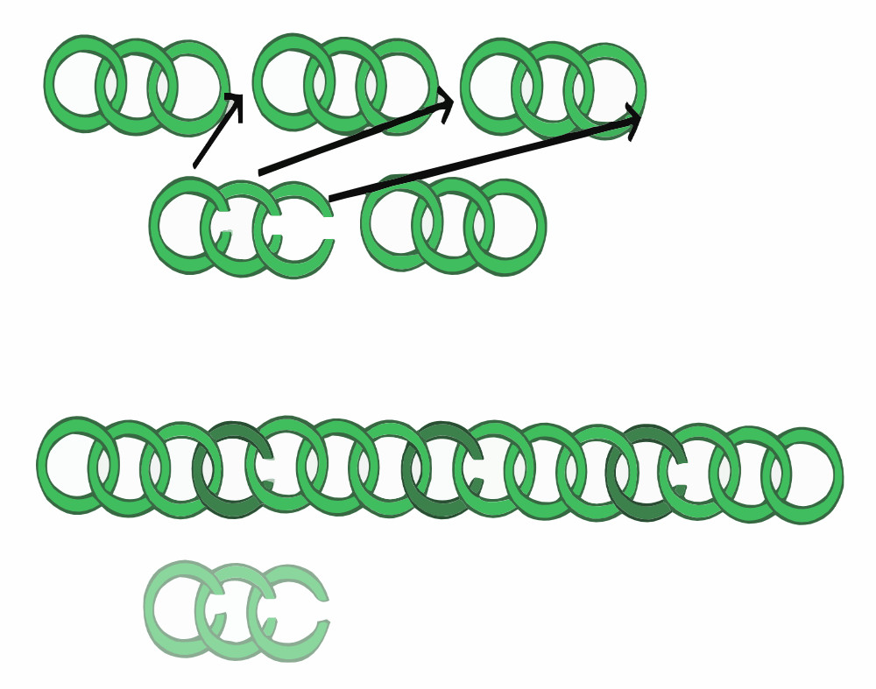
Chain Link
You have five pieces of chain, each consisting of three links. You want to make one long chain of these five pieces. Breaking open a link costs 1 Rs, and welding an open link costs 3 Rs. Is it possible to make one long chain of the five pieces, if you have just 15 Rs?

Slide 14
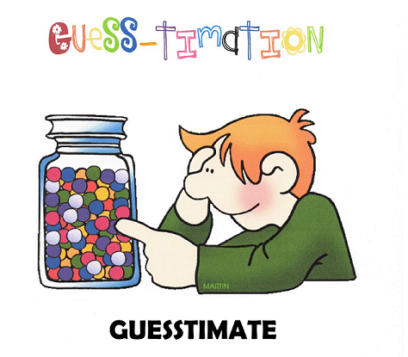
Notes:
Business and Finance:
Market analysis
Customer segmentation
Credit risk assessment
Fraud detection
Investment portfolio management
Financial forecasting
Healthcare:
Disease diagnosis
Drug discovery
Patient outcomes analysis
Healthcare resource optimization
Epidemiological studies
Retail and E-Commerce:
Sales and inventory optimization
Customer behavior analysis
Personalized marketing
Supply chain management
Price optimization
Government and Public Policy:
Public policy analysis
Crime pattern recognition
Social program effectiveness
Traffic and transportation management
Election forecasting
Energy and Utilities:
Energy consumption optimization
Predictive maintenance of infrastructure
Renewable energy resource management
Grid management
Marketing and Advertising:
Ad campaign performance analysis
Social media analytics
Customer sentiment analysis
Click-through rate prediction
A/B testing
Manufacturing and Supply Chain:
Quality control and defect detection
Inventory management
Production process optimization
Supplier relationship management
Telecommunications:
Network performance monitoring
Customer churn prediction
Service quality improvement
Infrastructure optimization
Education:
Student performance analysis
Adaptive learning systems
Educational program assessment
Resource allocation
Transportation and Logistics:
Route optimization
Demand forecasting
Fleet management
Delivery scheduling
Entertainment and Media:
Content recommendation
Audience engagement analysis
Box office predictions
User behavior modeling
Environmental Science:
Climate change analysis
Natural disaster prediction and response
Ecosystem monitoring
Conservation efforts
Human Resources:
Employee performance analysis
Workforce planning
Recruitment and talent acquisition
Employee satisfaction surveys
Sports Analytics:
Player performance analysis
Game strategy optimization
Fan engagement
Athlete injury prevention
Supply Chain Management:
Demand forecasting
Inventory optimization
Supplier performance analysis
Logistics and distribution management
Social Services:
Child welfare and protection
Homelessness prevention
Elderly care optimization
Social program evaluation
Agriculture:
Crop yield prediction
Pest and disease detection
Precision farming
Irrigation management
Sustainability and Environmental Conservation:
Sustainable resource management
Pollution monitoring and control
Wildlife conservation efforts
These are just a few examples of the diverse domains in which data analytics plays a critical role in improving decision-making, efficiency, and outcomes. The applications of data analytics continue to grow as more organizations recognize its value in harnessing the power of data.

Slide 15
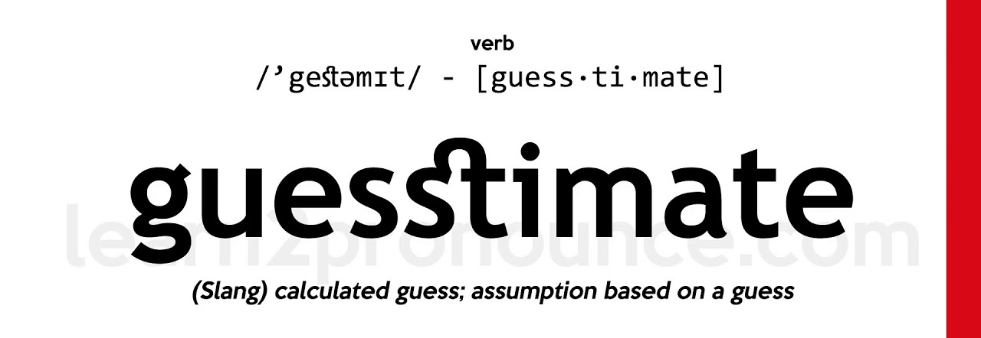
Notes:
Business and Finance:
Market analysis
Customer segmentation
Credit risk assessment
Fraud detection
Investment portfolio management
Financial forecasting
Healthcare:
Disease diagnosis
Drug discovery
Patient outcomes analysis
Healthcare resource optimization
Epidemiological studies
Retail and E-Commerce:
Sales and inventory optimization
Customer behavior analysis
Personalized marketing
Supply chain management
Price optimization
Government and Public Policy:
Public policy analysis
Crime pattern recognition
Social program effectiveness
Traffic and transportation management
Election forecasting
Energy and Utilities:
Energy consumption optimization
Predictive maintenance of infrastructure
Renewable energy resource management
Grid management
Marketing and Advertising:
Ad campaign performance analysis
Social media analytics
Customer sentiment analysis
Click-through rate prediction
A/B testing
Manufacturing and Supply Chain:
Quality control and defect detection
Inventory management
Production process optimization
Supplier relationship management
Telecommunications:
Network performance monitoring
Customer churn prediction
Service quality improvement
Infrastructure optimization
Education:
Student performance analysis
Adaptive learning systems
Educational program assessment
Resource allocation
Transportation and Logistics:
Route optimization
Demand forecasting
Fleet management
Delivery scheduling
Entertainment and Media:
Content recommendation
Audience engagement analysis
Box office predictions
User behavior modeling
Environmental Science:
Climate change analysis
Natural disaster prediction and response
Ecosystem monitoring
Conservation efforts
Human Resources:
Employee performance analysis
Workforce planning
Recruitment and talent acquisition
Employee satisfaction surveys
Sports Analytics:
Player performance analysis
Game strategy optimization
Fan engagement
Athlete injury prevention
Supply Chain Management:
Demand forecasting
Inventory optimization
Supplier performance analysis
Logistics and distribution management
Social Services:
Child welfare and protection
Homelessness prevention
Elderly care optimization
Social program evaluation
Agriculture:
Crop yield prediction
Pest and disease detection
Precision farming
Irrigation management
Sustainability and Environmental Conservation:
Sustainable resource management
Pollution monitoring and control
Wildlife conservation efforts
These are just a few examples of the diverse domains in which data analytics plays a critical role in improving decision-making, efficiency, and outcomes. The applications of data analytics continue to grow as more organizations recognize its value in harnessing the power of data.

Slide 16
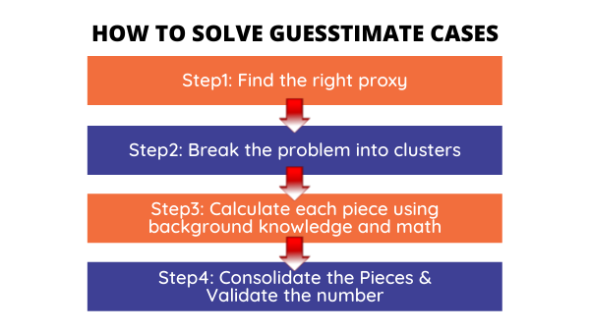
Notes:
Business and Finance:
Market analysis
Customer segmentation
Credit risk assessment
Fraud detection
Investment portfolio management
Financial forecasting
Healthcare:
Disease diagnosis
Drug discovery
Patient outcomes analysis
Healthcare resource optimization
Epidemiological studies
Retail and E-Commerce:
Sales and inventory optimization
Customer behavior analysis
Personalized marketing
Supply chain management
Price optimization
Government and Public Policy:
Public policy analysis
Crime pattern recognition
Social program effectiveness
Traffic and transportation management
Election forecasting
Energy and Utilities:
Energy consumption optimization
Predictive maintenance of infrastructure
Renewable energy resource management
Grid management
Marketing and Advertising:
Ad campaign performance analysis
Social media analytics
Customer sentiment analysis
Click-through rate prediction
A/B testing
Manufacturing and Supply Chain:
Quality control and defect detection
Inventory management
Production process optimization
Supplier relationship management
Telecommunications:
Network performance monitoring
Customer churn prediction
Service quality improvement
Infrastructure optimization
Education:
Student performance analysis
Adaptive learning systems
Educational program assessment
Resource allocation
Transportation and Logistics:
Route optimization
Demand forecasting
Fleet management
Delivery scheduling
Entertainment and Media:
Content recommendation
Audience engagement analysis
Box office predictions
User behavior modeling
Environmental Science:
Climate change analysis
Natural disaster prediction and response
Ecosystem monitoring
Conservation efforts
Human Resources:
Employee performance analysis
Workforce planning
Recruitment and talent acquisition
Employee satisfaction surveys
Sports Analytics:
Player performance analysis
Game strategy optimization
Fan engagement
Athlete injury prevention
Supply Chain Management:
Demand forecasting
Inventory optimization
Supplier performance analysis
Logistics and distribution management
Social Services:
Child welfare and protection
Homelessness prevention
Elderly care optimization
Social program evaluation
Agriculture:
Crop yield prediction
Pest and disease detection
Precision farming
Irrigation management
Sustainability and Environmental Conservation:
Sustainable resource management
Pollution monitoring and control
Wildlife conservation efforts
These are just a few examples of the diverse domains in which data analytics plays a critical role in improving decision-making, efficiency, and outcomes. The applications of data analytics continue to grow as more organizations recognize its value in harnessing the power of data.

Slide 17

How many people in India use iPhones?

Slide 18

Estimate the number of Uber rides in Delhi?

Slide 19

How many cups of tea were consumed in Mumbai last month?

Slide 20
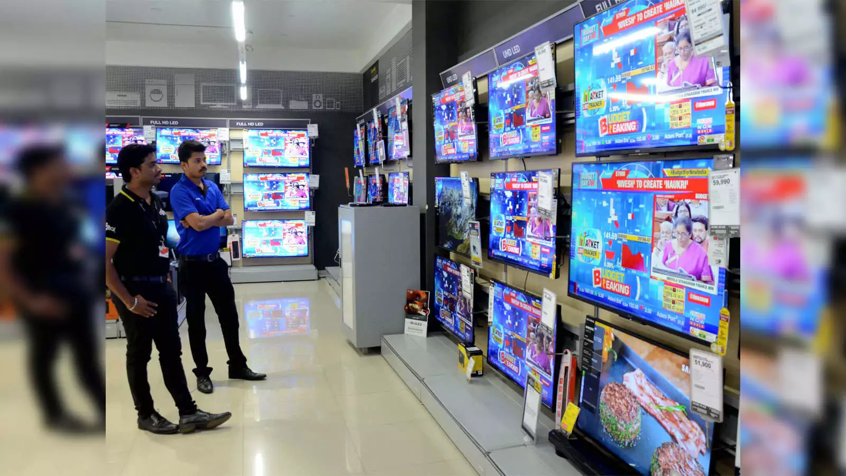
Estimate the number of televisions sold in india every month.

Slide 21
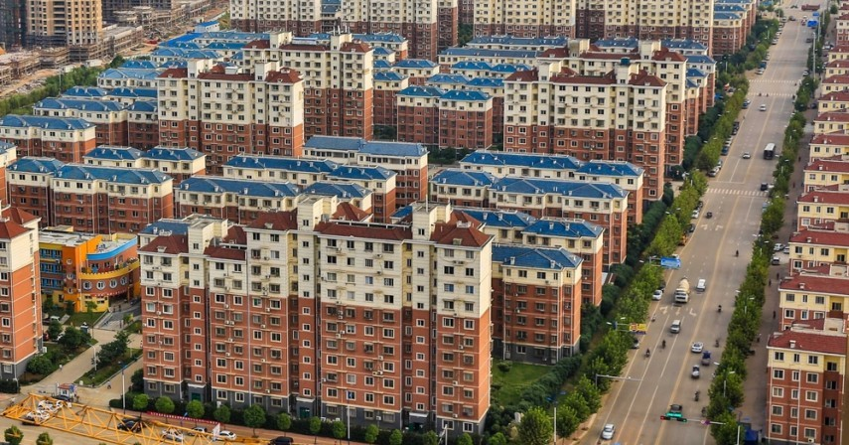
How many people live in your housing society?

Slide 22

Q & A
Ask your questions

Slide 23
THANK YOU

